Slide 1
Sandy Beach Ecology
At the end of this lesson, you should be able to:
Characterize sand.
Compare ocean movements.
Describe beach formation.
Illustrate the zones of the beach.
Rockaway Beach, NY

Slide 2
Characteristics of Sandy Beach ecosystems:
How do you know you are at the beach?
Notes:
Ask students: how do you know you are at the beach?
Ocean (large body of water), Sand, Open space, wind, sun, lack of shade (lack of trees/vegetation)

Slide 3
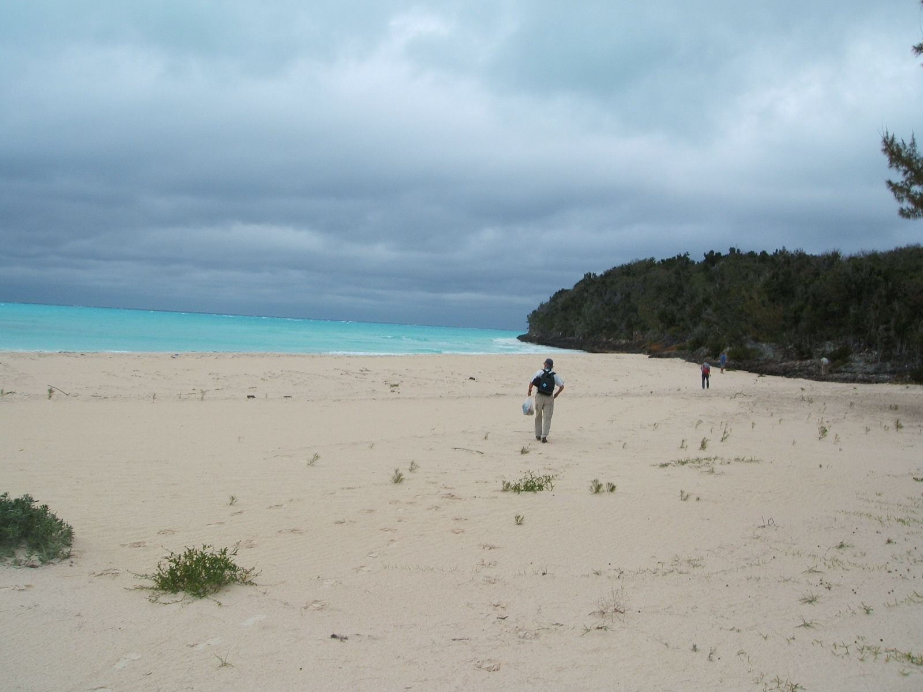
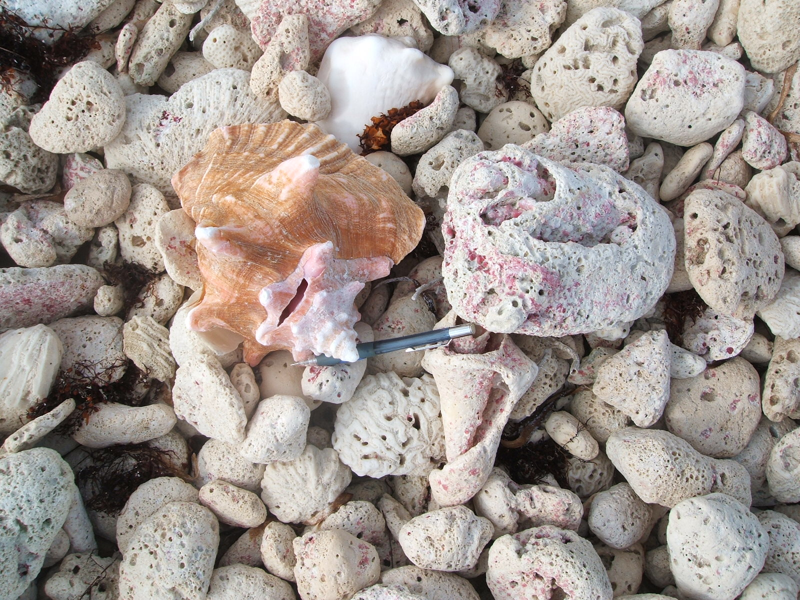
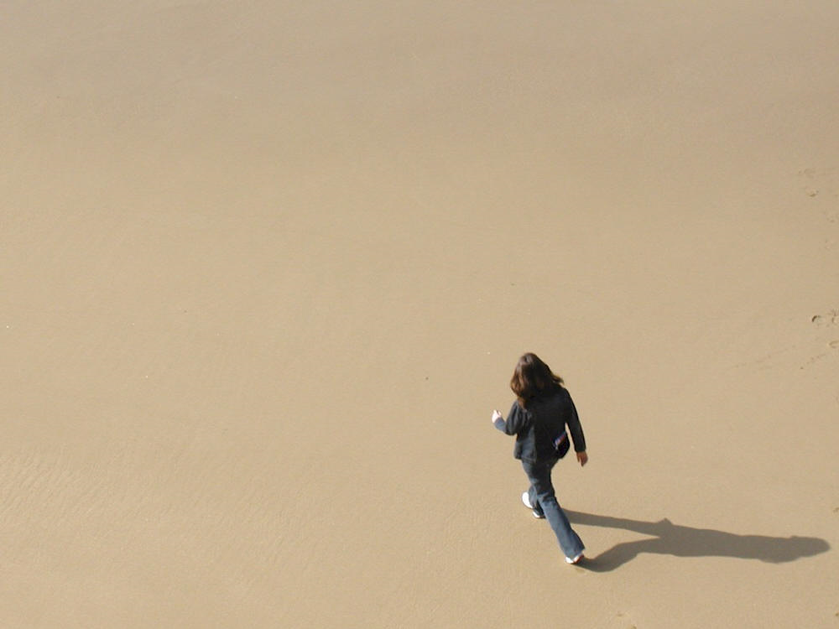
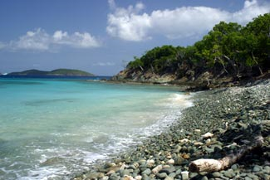
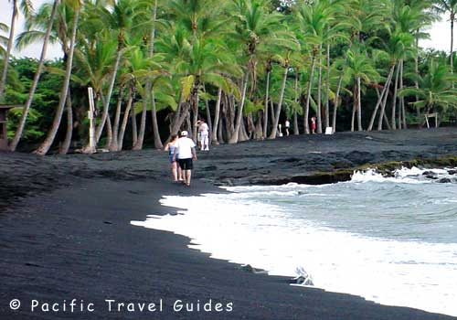
Where does sand come from?

Slide 4
Sand is made of fragments of rocks
In geology, sand is strictly made of particles that are 1/16 mm up to 2 mm in size.
Notes:
Ask students how do you think rocks are broken into fragments? (wind, water, waves) Introduce term: WEATHERING
Advise students of grain size scale.

Slide 5
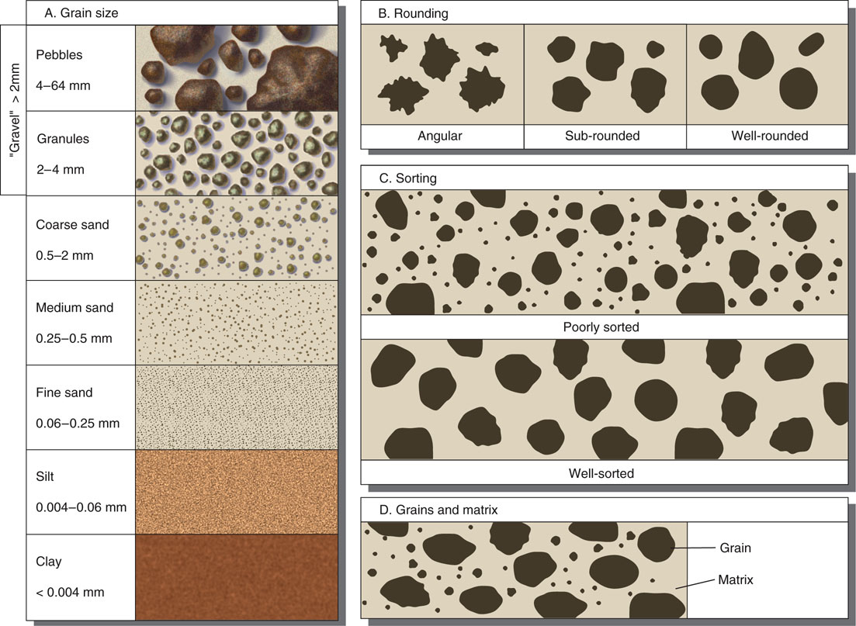
Grain sizes
Notes:
Point out differences in grain size: important for earth science; not now though. My quote: “Wisdom is knowing how much you don’t know”
Ask about age and weathering of sand is Rounding and Sorting charts.

Slide 6
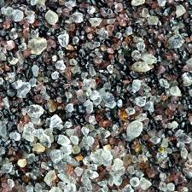
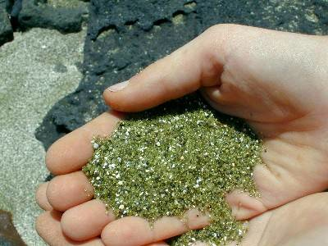
Sand is made of minerals and organics
Sand from different locations can vary dramatically in color
White, clear= Quartz
Peach, beige, reddish brown= Feldspar
Black= Magnetite or basalt
Green= Olivine
Gold, Silver, glittery= Mica
Pink- dark red= Garnet
White, pink (milky)= CaCO3 seashells and coral

Slide 7
What is an Ocean?
a large body of salt water that covers most of the Earth
Most of the oxygen we breathe comes from phytoplankton in the ocean, not trees
The ocean contains more than 97% of the world’s water, but less than 10% of the ocean has been explored.
Sound travels over 4 times faster in the ocean than it does on land.
Notes:
Can anybody name the 4 (or 5) oceans?

Slide 8
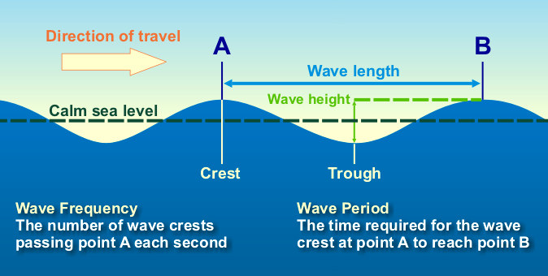
What is a Wave?
Winds cause waves on the surface of the ocean
Waves of water do not move horizontally, they only move up and down
http://www.srh.weather.gov/jetstream/ocean/wave_max.htmhttp://dusk.geo.orst.edu/oceans/PPT/fig07_03a.mov
http://ees.as.uky.edu/sites/default/files/elearning/module14swf.swf

Slide 9
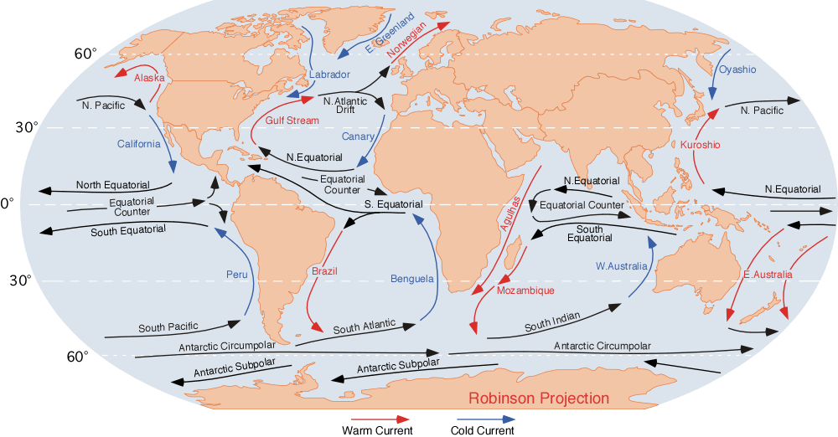
Another type of movement in the ocean: CURRENTS

Slide 10
How are Currents different from Waves?
Currents are movements of the ocean. Unlike waves, the movement of currents can transport things from place to place.
Currents are caused by wind, temperature gradients (differences in heat from one area to another), and density gradients (???).
Currents move sand, debris, plankton

Slide 11
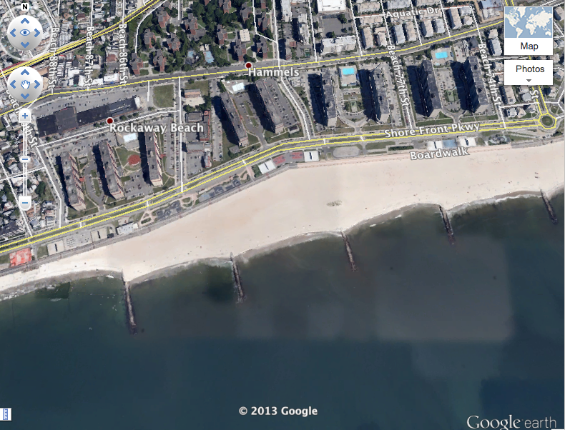
Longshore currents
These currents move sand horizontally along the beach.
The purpose of jetties is to hold the sand in place.
Notes:
Ask students: which way does the longshore current appear to be depositing sand?

Slide 12
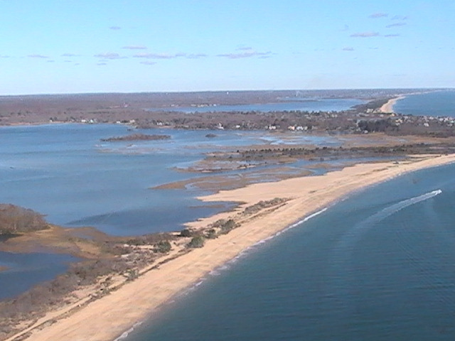
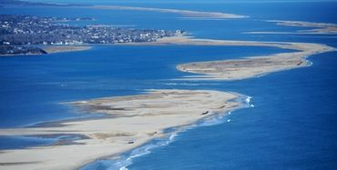
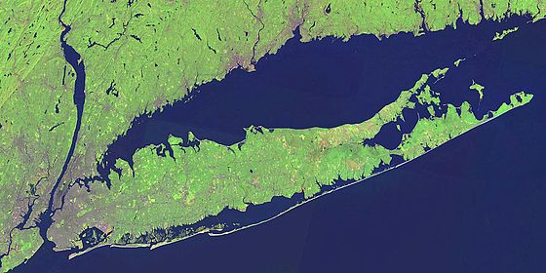
What is a Barrier Beach?

Slide 13
How are barrier beaches formed?

Slide 14
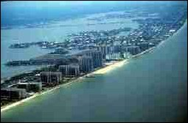
Barrier beaches are often home to extensive development.

Slide 15
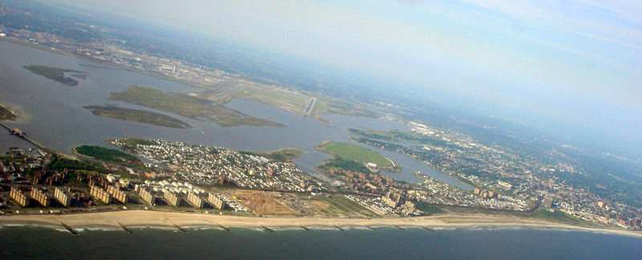
Rockaway is a barrier beach

Slide 16
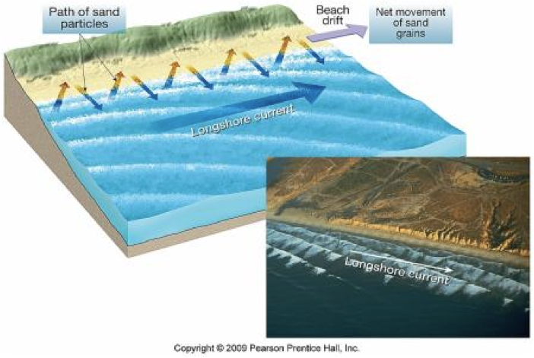
What forces shape a beach?

Slide 17
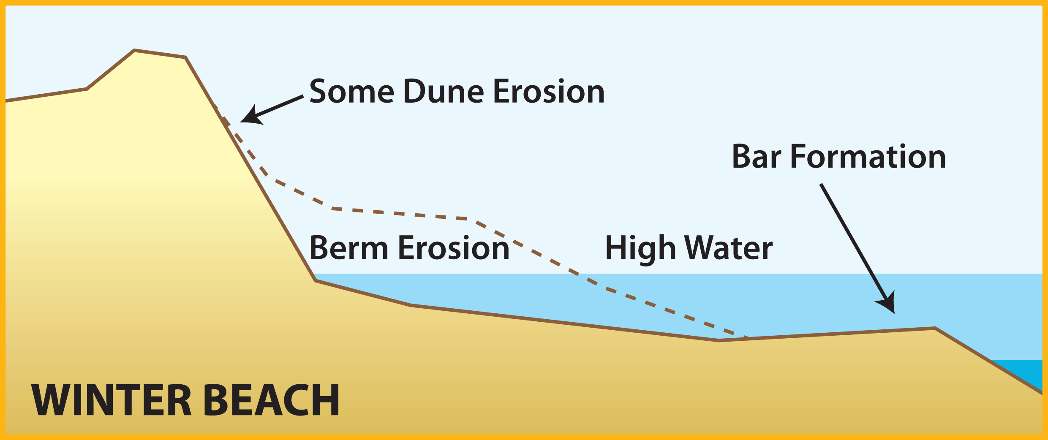
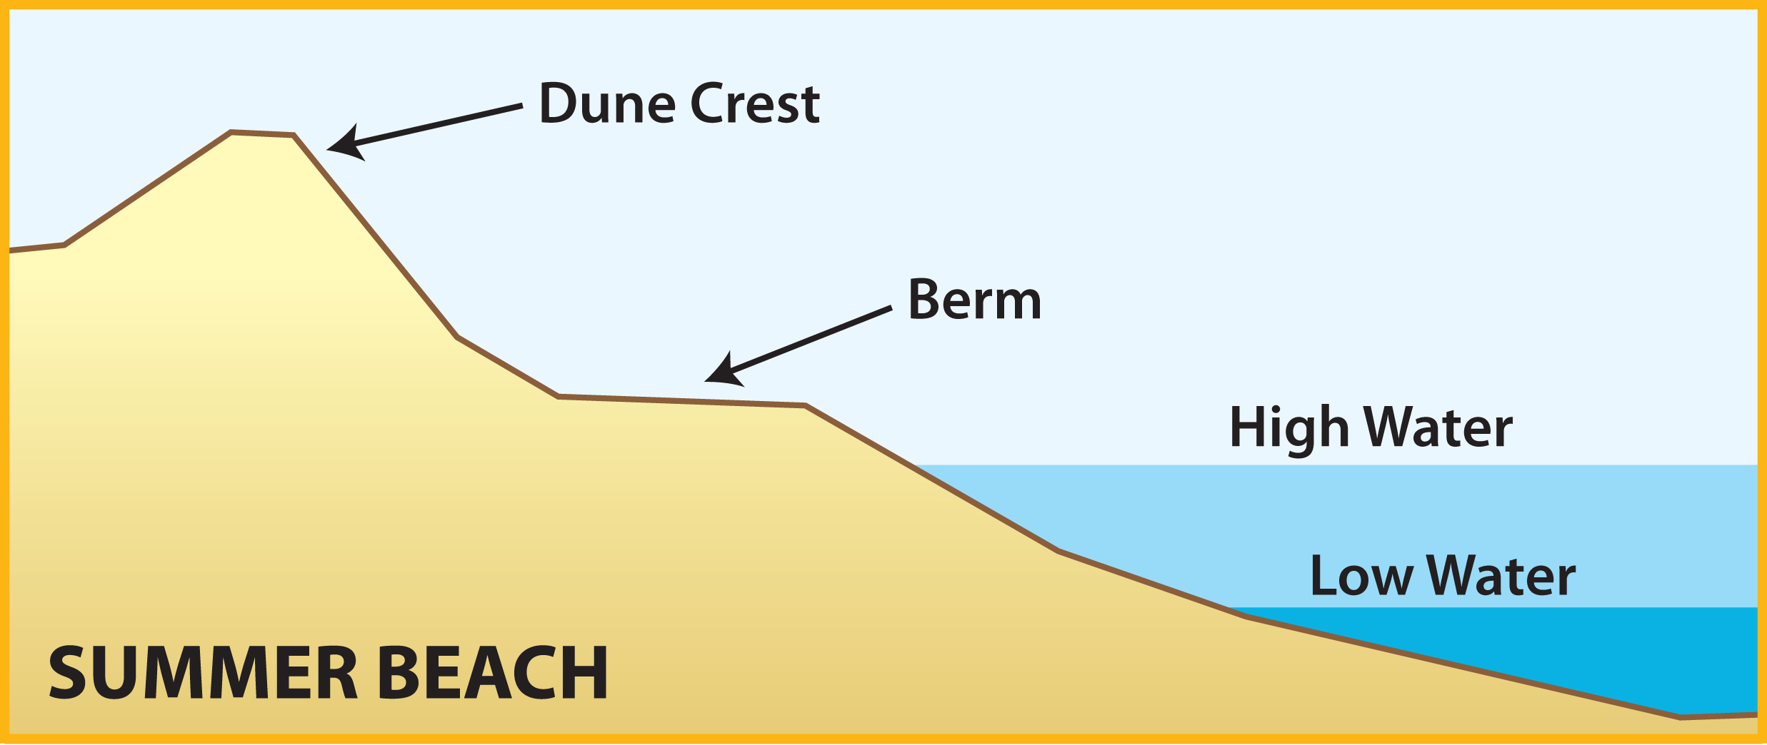
Storms and waves are stronger in the winter, so the beach changes shape…

Slide 18
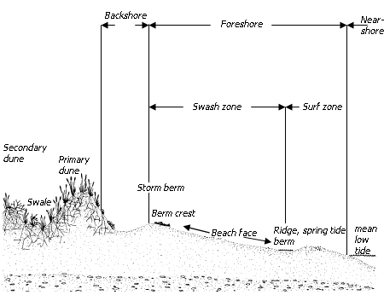
What are the Zones of the Beach?

