Slide 1
Name of Biome
Names of group members
Project Manager

Slide 2
Where are the __________ located?
Map of world with locations of this biome highlighted
Geologist: Name

Slide 3
What is the climate like?
Climatogram for City_______
Climatogram for city_______
Geologist: Name

Slide 4
Abiotic Factors
Abiotic Factor | Description | How it affects plants/ animals/people in this Biome
Temperature
Precipitation
Seasons | (How does the weather change with the seasons? Or does it change at all?)
Wind or other factors
Geologist: Name

Slide 5
The (Nitrogen or Water or Carbon-Oxygen cycle) in my BIOME
Geologist: Name

Slide 6
Interesting facts about extreme weather or soil or other abiotic conditions in my biome
Geologist: Name

Slide 7
5 or more multiple choice questions on my topic
Geologist: Name

Slide 8
Plants from (myBiome)
6 images with common name and scientific name of plants underneath
Botanist: Name

Slide 9
Plants from (myBiome)
Plant 1: Common name and Scientific Name
Plant 2: Common name and Scientific Name
Picture
Medicinal uses:
Human uses:
Which animals eat this plant?
Picture
Medicinal uses:
Human uses:
Which animals eat this plant?
Botanist: Name

Slide 10
Plants from (myBiome)
Plant 3: Common name and Scientific Name
Plant 4: Common name and Scientific Name
Picture
Medicinal uses:
Human uses:
Which animals eat this plant?
Picture
Medicinal uses:
Human uses:
Which animals eat this plant?
Botanist: Name

Slide 11
Plants from (myBiome)
Plant 5: Common name and Scientific Name
Plant 6: Common name and Scientific Name
Picture
Medicinal uses:
Human uses:
Which animals eat this plant?
Picture
Medicinal uses:
Human uses:
Which animals eat this plant?
Botanist: Name

Slide 12
An Endangered Plant from (my Biome)
Common and Scientific Name
Why is it endangered?
How many are left?
What can humans do to protect this plant?
Botanist: Name

Slide 13
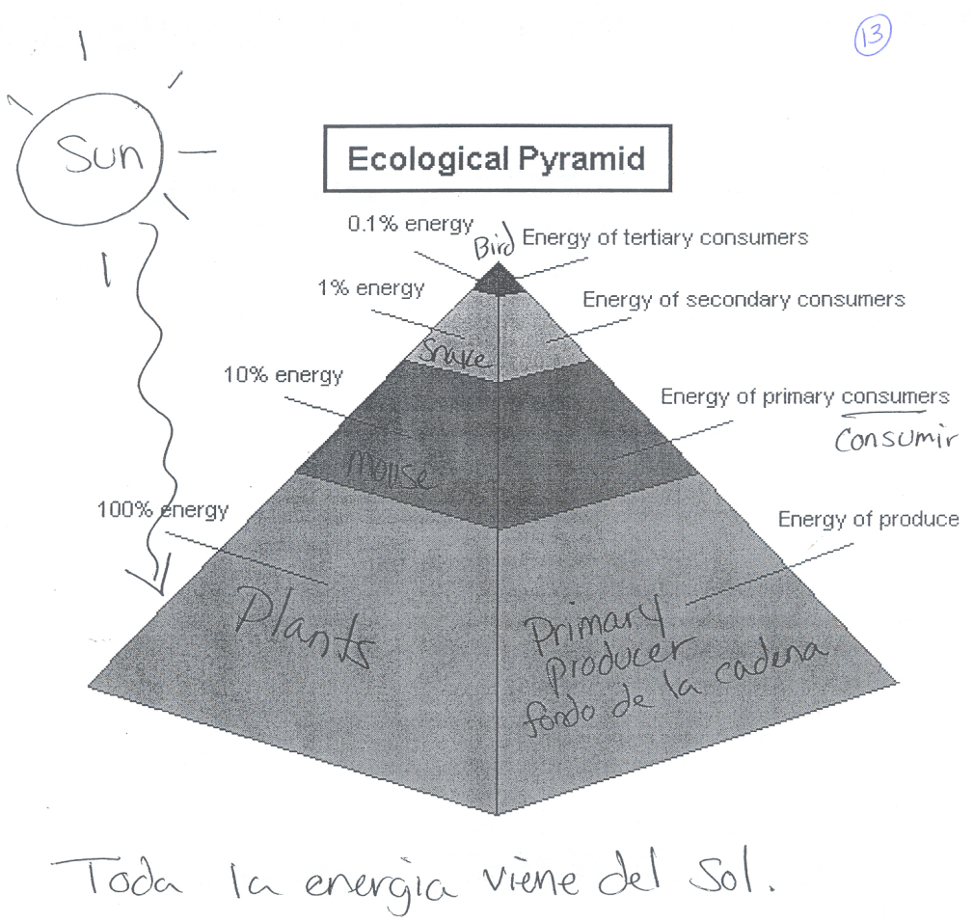
A Trophic pyramid from ________
It will look something like this:
Botanist: Name

Slide 14
More interesting facts or pictures about producers
Botanist: Name

Slide 15
5 or more multiple choice questions on my topic
Botanist: Name

Slide 16
Animals from (myBiome)
6 images with common name and scientific name of animals underneath
Zoologist: Name

Slide 17
Animals from (myBiome)
Animal 1: Common name and Scientific Name
Animal 2: Common name and Scientific Name
Pictures:
Predators:
Prey:
Pictures:
Predators:
Prey:
Zoologist: Name

Slide 18
Animals from (myBiome)
Animal 3: Common name and Scientific Name
Animal 4: Common name and Scientific Name
Pictures:
Predators:
Prey:
Pictures:
Predators:
Prey:
Zoologist: Name

Slide 19
Animals from (myBiome)
Animal 5: Common name and Scientific Name
Animal 6: Common name and Scientific Name
Pictures:
Predators:
Prey:
Pictures:
Predators:
Prey:
Zoologist: Name

Slide 20
An Endangered Animal from (my Biome)
Common and Scientific Name
Why is it endangered?
How many are left?
What can humans do to protect this animal?
Botanist: Name

Slide 21
A Food web from ________
It will look something like this:
Zoologist: Name

Slide 22
More interesting facts or pictures about consumers
Zoologist: Name

Slide 23
5 or more multiple choice questions on my topic
Zoologist: Name

Slide 24
Resources humans use or harvest from this biome
Include pics
Anthropologist: Name

Slide 25
Areas colonized in the past
And why? (for what resources or purposes?)
Anthropologist: Name

Slide 26
Visit (my Biome)
Best time of year to visit!
Cost for airfare
Show pic.
Why?
JFK --> a city in your biome (ask the geographer)
Then go to Kayak.com and search for flights at the best time of year.
Anthropologist: Name

Slide 27
Visiting (my Biome)
Exciting things to do
Public parks or preserves or other nature places to visit
pics
pics
Anthropologist: Name

Slide 28
What do people in this region wear?
Anthropologist: Name

Slide 29
3 negative human impacts on (my Biome)
First Negative impact, how we can prevent it, 1 pic
Second Negative impact, how we can prevent it, 1 pic
Third Negative impact, how we can prevent it, 1 pic
Anthropologist: Name

Slide 30
5 or more multiple choice questions on my topic
Anthropologist: Name

Slide 31
List of all multiple choice questions

Slide 32
A fun exciting closing slide Maybe pictures of all the members
Project Manager

